Slide 1
The ELK Stack @ Linko
Jilles van Gurp - Linko Inc.

Slide 2


Slide 3
Who is Jilles?
@jillesvangurp, www.jillesvangurp.com, and jillesvangurp on Github & just about everything else.
Java (J)Ruby Python Javascript GEO
Server stuff reluctant Devops guy Software Architecture
Universities of Utrecht (NL), Blekinge (SE), and Groningen (NL)
GX Creative Online Development (NL)
Nokia Research (FI), Nokia/Here (DE)
Localstream (DE), Linko (DE).

Slide 4
Logging
Stuff runs
Produces errors, warnings, debug, telemetry, analytics events, and other information
How to make sense of it?

Slide 5
Old school: Cat, grep, awk, cut, ….
Good luck with that on 200GB of unstructured logs. Think lots of coffee breaks.
The fix: ELK

Slide 6
Or do the same stuff in Hadoop
Works great for structured data if you know what you are looking for.
Requires a lot of infrastructure and hassle.
Not real-time, hard to explore data
I’m not a data scientist, are you?
The fix: ELK

Slide 7
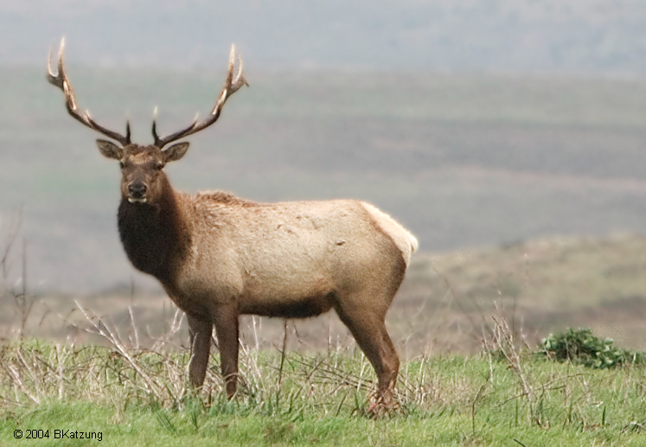
ELK Stack?
Elasticsearch
Logstash
Kibana

Slide 8
ELK - Elasticsearch
Sharded, replicated, searchable, json document store.
Used by many big name services out there - Github, Soundcloud, Foursquare, Xing, many others.
Full text search, geo spatial search, advanced search ranking, suggestions, … much more. It’s awesome.
Nice HTTP API

Slide 9
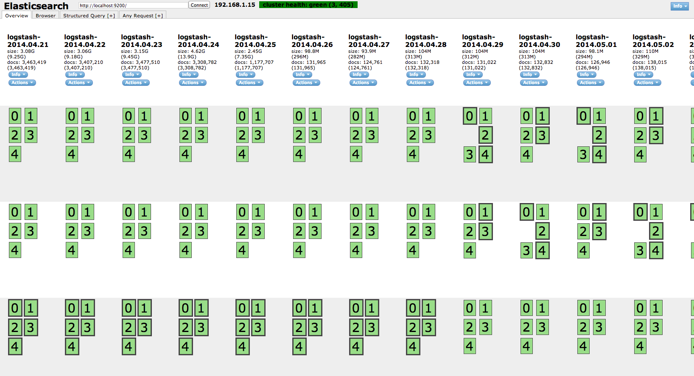

Slide 10
Scaling Elasticsearch
1 node, 16GB, all of open streetmap in geojson format (+ some other stuff) -> reverse geocode in <100ms
There are people running ES with thousands of nodes, trillions of documents, and petabytes ...

Slide 11
Bottom line
Elasticsearch scales, probably way beyond your needs
Log data is actually easy for elasticsearch

Slide 12
Elk - Logstash
Plumbing for your logs
Many different inputs for your logs
Filtering/parsing for your logs
Many outputs for your logs: for example redis, elasticsearch, file,

Slide 13
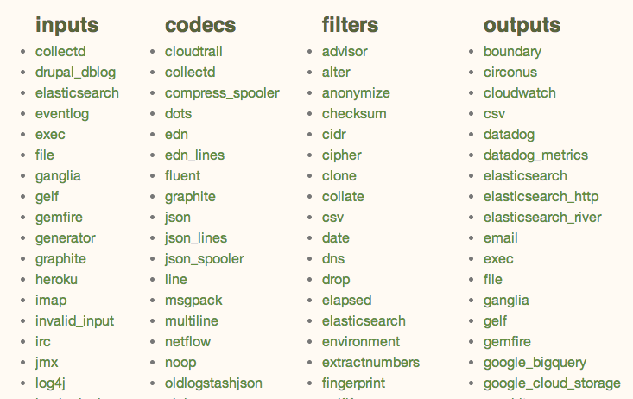

Slide 14
ELK - Kibana
Highly configurable dashboard to slice and dice your logstash logs in elasticsearch.
Real-time dashboards, easily configurable

Slide 15
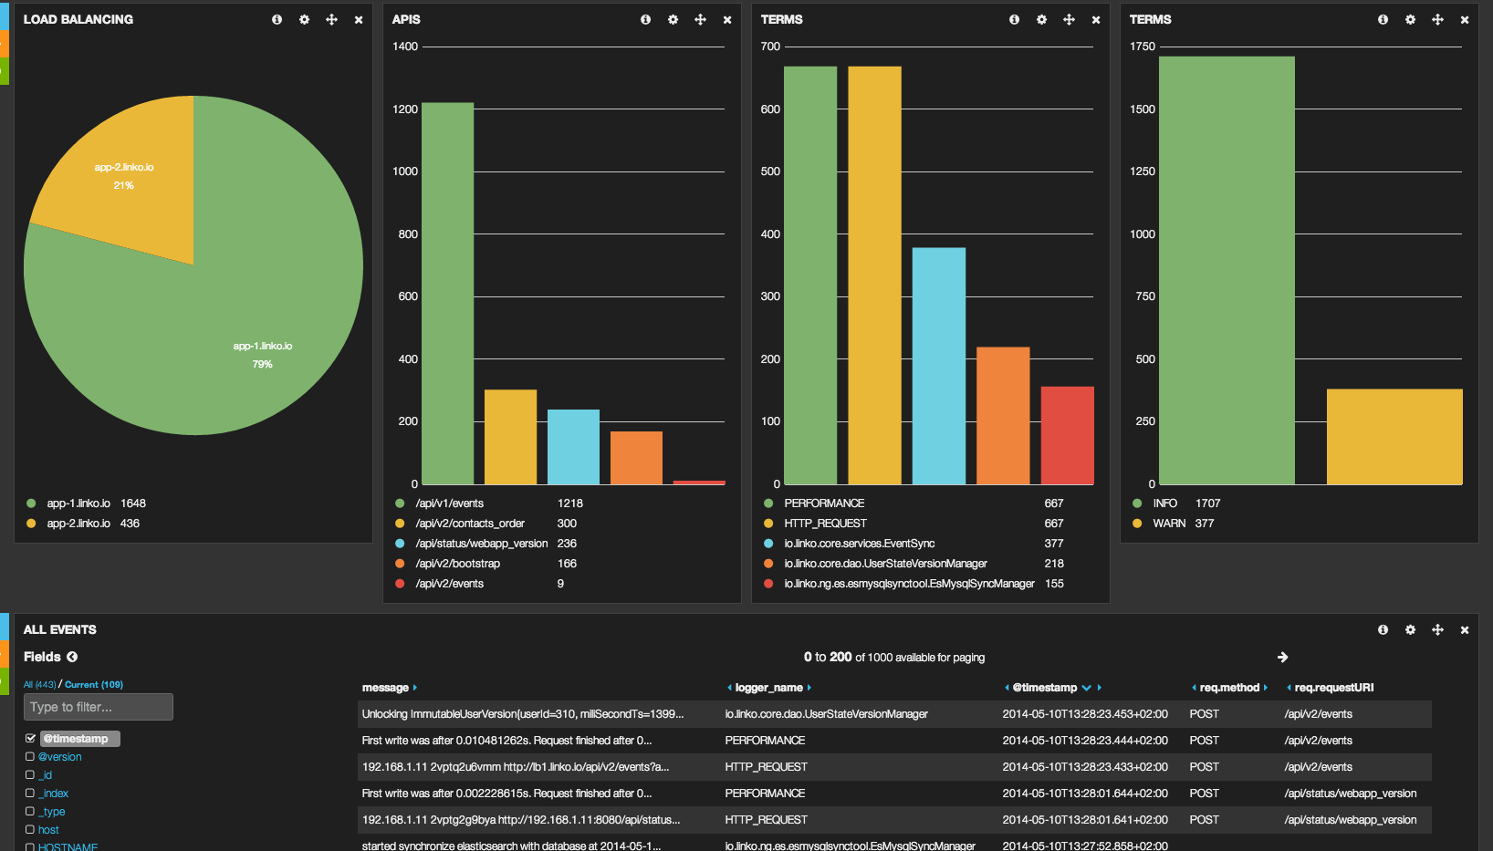

Slide 16
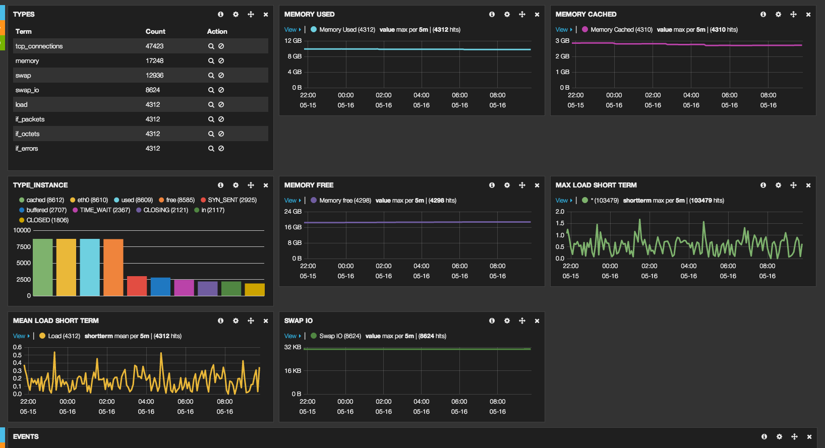

Slide 17


ELK at Linko
Java Logback
NGINX
collectd
APP Servers

Slide 18
Linko Logstash - App Server (1)
input {
file {
type => "nginx_access"
path => ["/var/log/nginx/*.log"]
exclude => ["*.gz”, “error.*"]
discover_interval => 10
sincedb_path => "/opt/logstash/sincedb-access-nginx"
}
}
filter {
grok {
type => "nginx_access"
patterns_dir => "/opt/logstash/patterns"
pattern => ["%{NGINXACCESSWITHUPSTR}","%{NGINXACCESS}"]
}
date {
type => "nginx_access"
locale => "en"
match => [ "time_local" , "dd/MMM/YYYY:HH:mm:ss Z" ]
}
}

Slide 19
Grok pattern for NGINX
NGINXACCESSWITHUPSTR %{IPORHOST:remote_addr} - %{USERNAME:remote_user} \[%{HTTPDATE:time_local}\] "%{WORD:method} %{URIPATHPARAM:request} %{GREEDYDATA:protocol}" %{INT:status} %{INT:body_bytes_sent} %{QS:http_referer} %{QS:http_user_agent} %{QS:backend} %{BASE16FLOAT:duration}
NGINXACCESS %{IPORHOST:remote_addr} - %{USERNAME:remote_user} \[%{HTTPDATE:time_local}\] %{QS:request} %{INT:status} %{INT:body_bytes_sent} %{QS:http_referer} %{QS:http_user_agent}

Slide 20
Linko Logstash - App Server (2)
input {
file {
type => "backbone"
path => "/var/log/linko-backbone/logstash/*.log"
codec => "json"
discover_interval => 10
sincedb_path => "/opt/logstash/sincedb-access-backbone"
}
}
input {
collectd {
type => 'collectd'
}
}
output {
redis {
host => "192.168.1.13"
data_type => "list"
key => "logstash"
}
}

Slide 21
Linko Logstash - Elasticsearch
input {
redis {
host => "192.168.1.13"
# these settings should match the output of the agent
data_type => "list"
key => "logstash"
# We use the 'json' codec here because we expect to read
# json events from redis.
codec => json
}
}
output {
elasticsearch_http {
host => "192.168.1.13"
manage_template => true
template_overwrite => true
template => "/opt/logstash/index_template.json"
}
}

Slide 22
Experience - mostly good
Many moving parts - each with their odd problems and issues
All parts are evolving. Prepare to upgrade.
Documentation is not great.

Slide 23
Finding out the hard way ...
Rolling restarts with elasticsearch
Configuring caching because of OOM’s
Clicking together dashboards in Kibana
Don’t restart cluster nodes blindly
Beware: Split brain
Default ES config is not appropriate for production

Slide 24
Gotchas
Kibana needs to talk to ES, but you don’t want that exposed to the world.
ES Fielddata cache is unrestricted, by default
Elasticsearch_http can fail silently, if misconfigured.
If you use file input, be sure to set the sincedb

Slide 25
Getting started
Download es & logstash to your laptop.
Simply run ES as is; worry about config later
Follow logstash cookbook to get started
Setup some simple inputs
Use elasticsearch_http, not elasticsearch output
Install kibana plugin in es
Open your browser

Slide 26
After getting started
RTFM, play, explore, mess up, google, …
Configure ES properly
Setup nginx/apache to proxy
Think about retention policies
...

Slide 27
Links
http://www.elasticsearch.org/
http://linko.io
https://groups.google.com/forum/?fromgroups=#!forum/elasticsearch
http://www.jillesvangurp.com

Slide 28
Thanks!
@jillesvangurp, @linkoapp

